Slide 1


Presented by Mohamed Nabih
Analysis of Film Industry
Trends and challenges

Slide 2

Introduction to results analysis
Director Analysis
Film Analysis
Genre Analysis
Film Trends Over Time
Data Relationships

Slide 3

1. Director Analysis:
Top Directors by Number of Films
Top Directors by Budget and Revenue

Slide 4

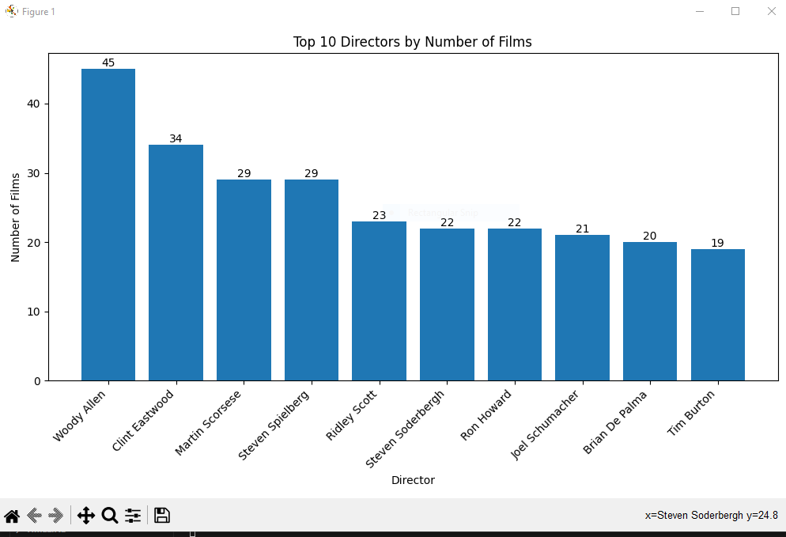

Top Directors by Number of Films

Slide 5
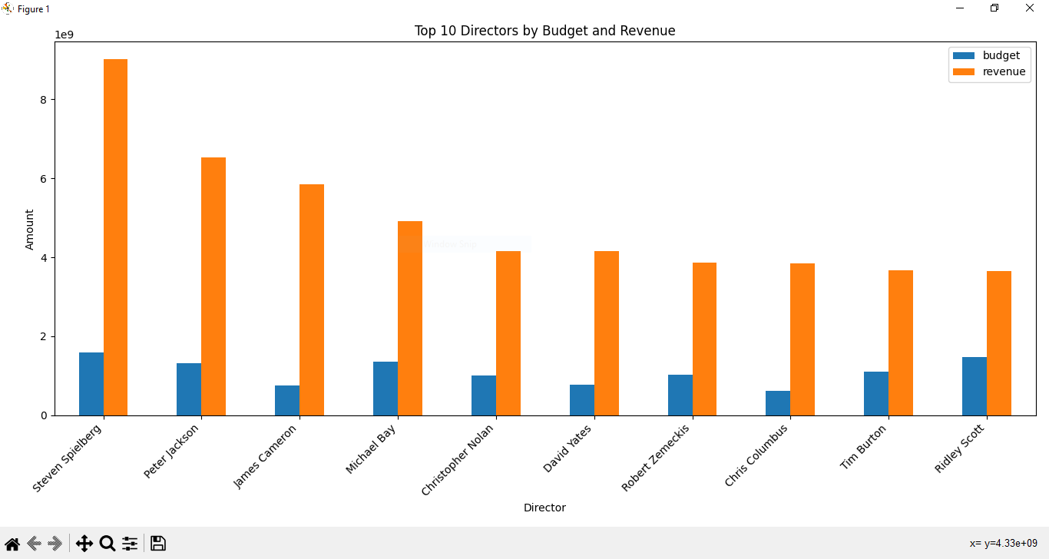
Top Directors by Budget and Revenue

Slide 6
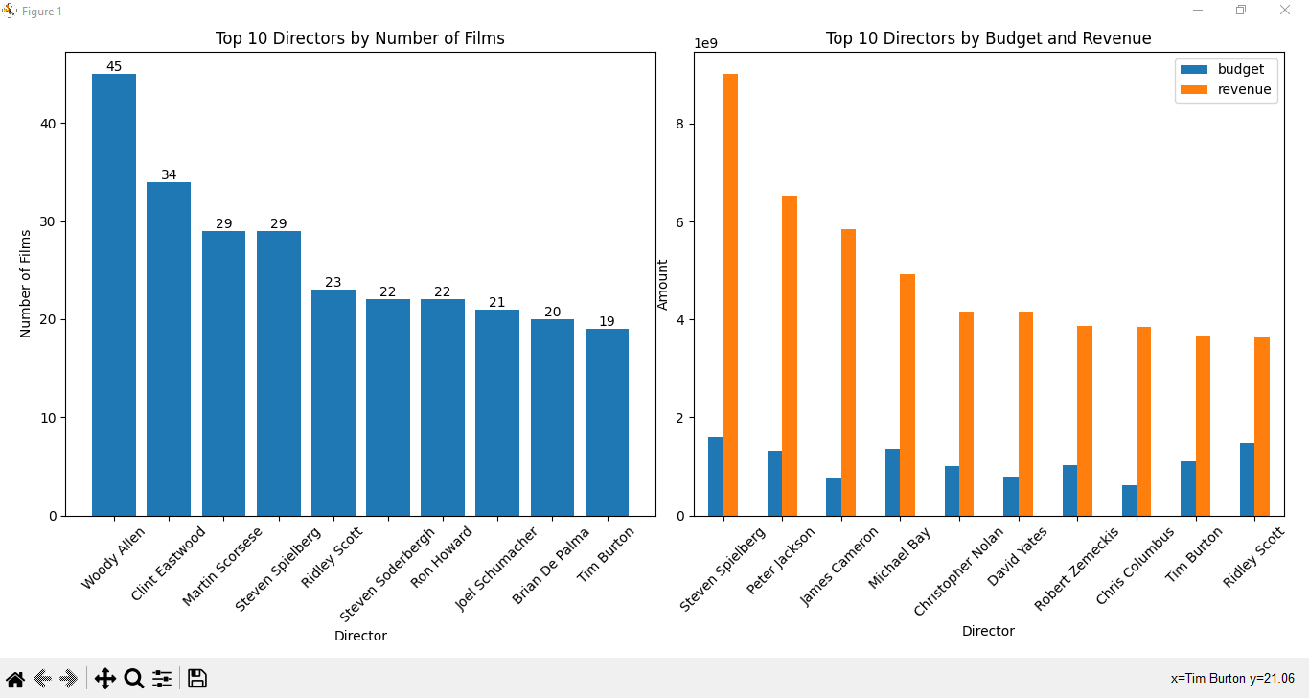
DashBoard

Slide 7

2. Film Analysis:
Top Films by Budget and Revenue
Revenue and Popularity of Top 10 Most Popular Films
Top 10 Actors by Number of Films
Top 10 Production Companies by Number of Films

Slide 8

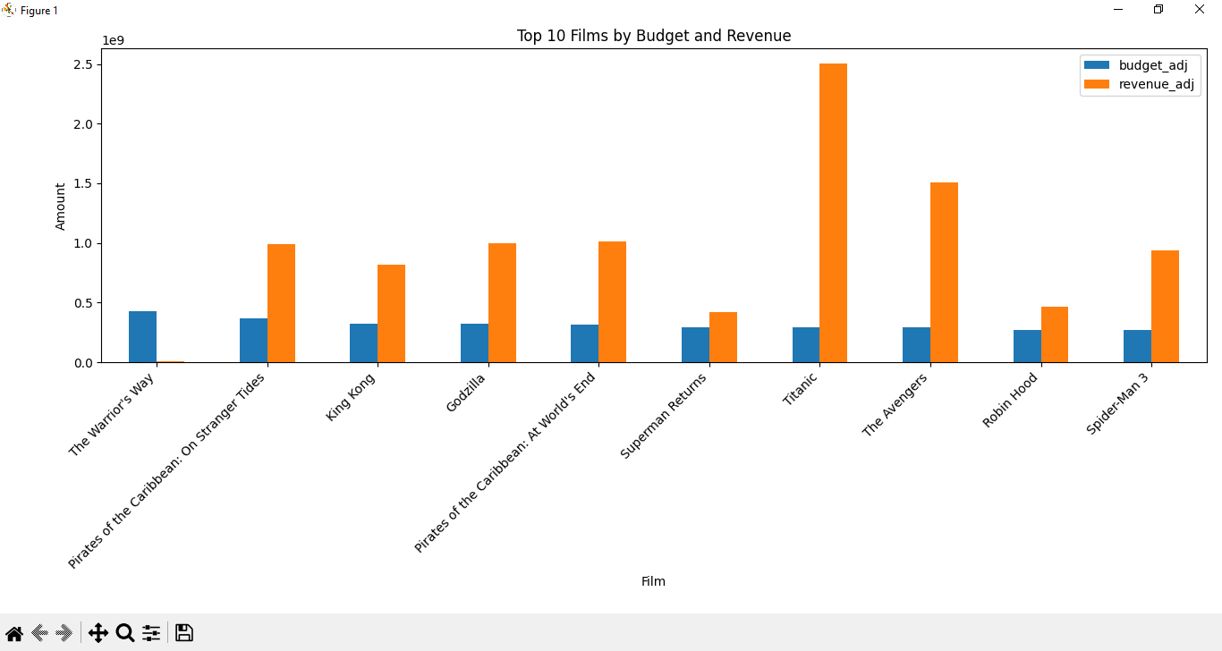
Top Films by Budget and Revenue

Slide 9
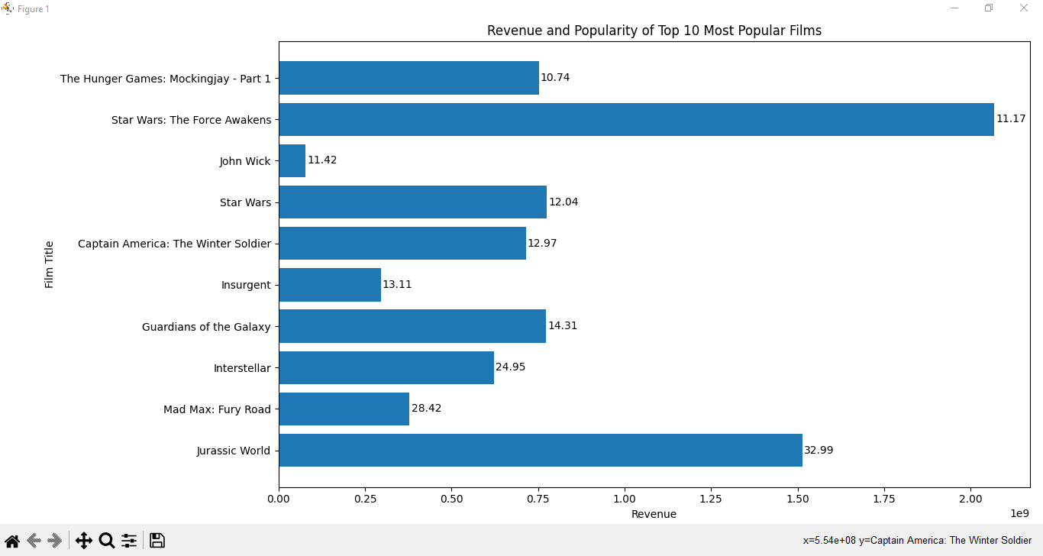
Revenue and Popularity of Top 10 Most Popular Films

Slide 10
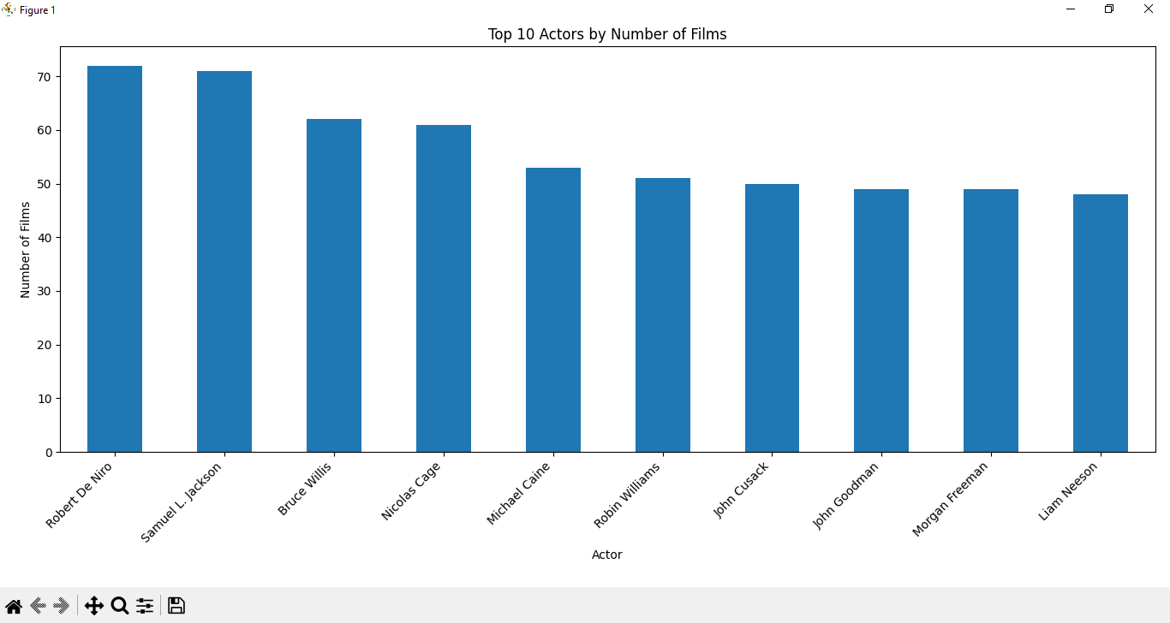
Top 10 Actors by Number of Films

Slide 11
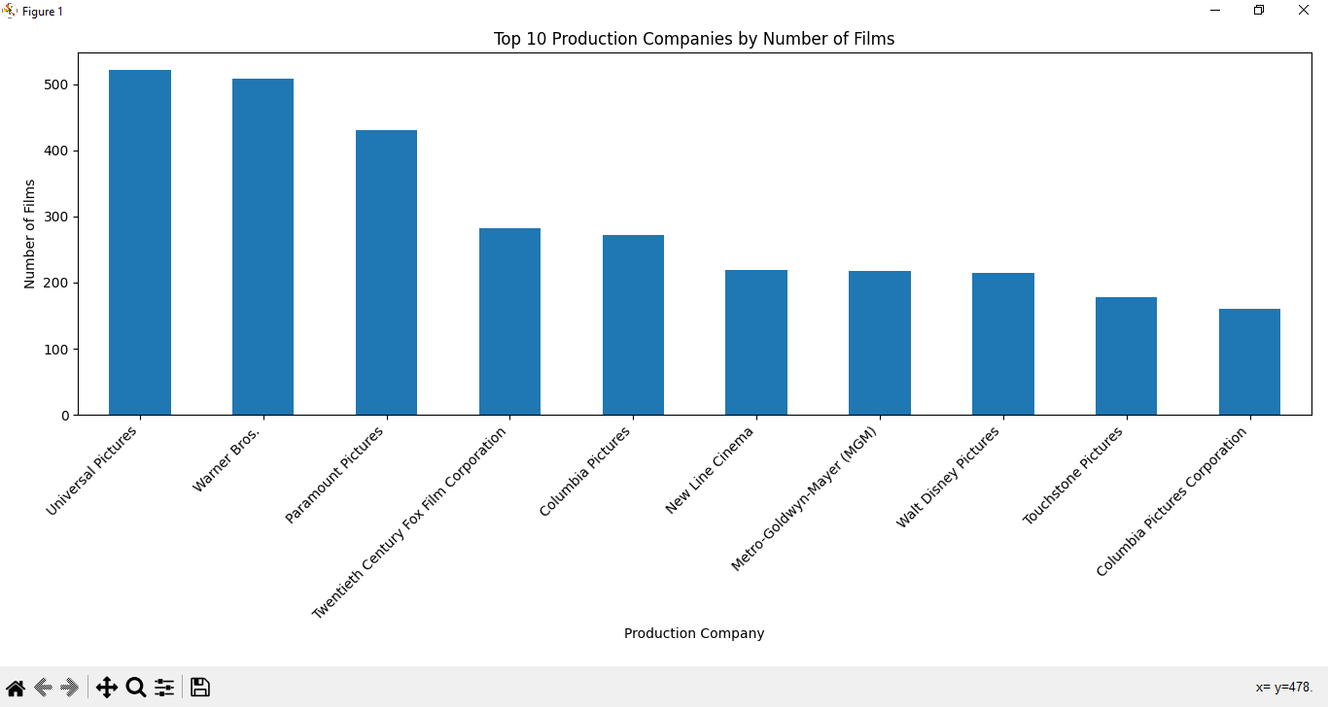
Top 10 Production Companies by Number of Films

Slide 12
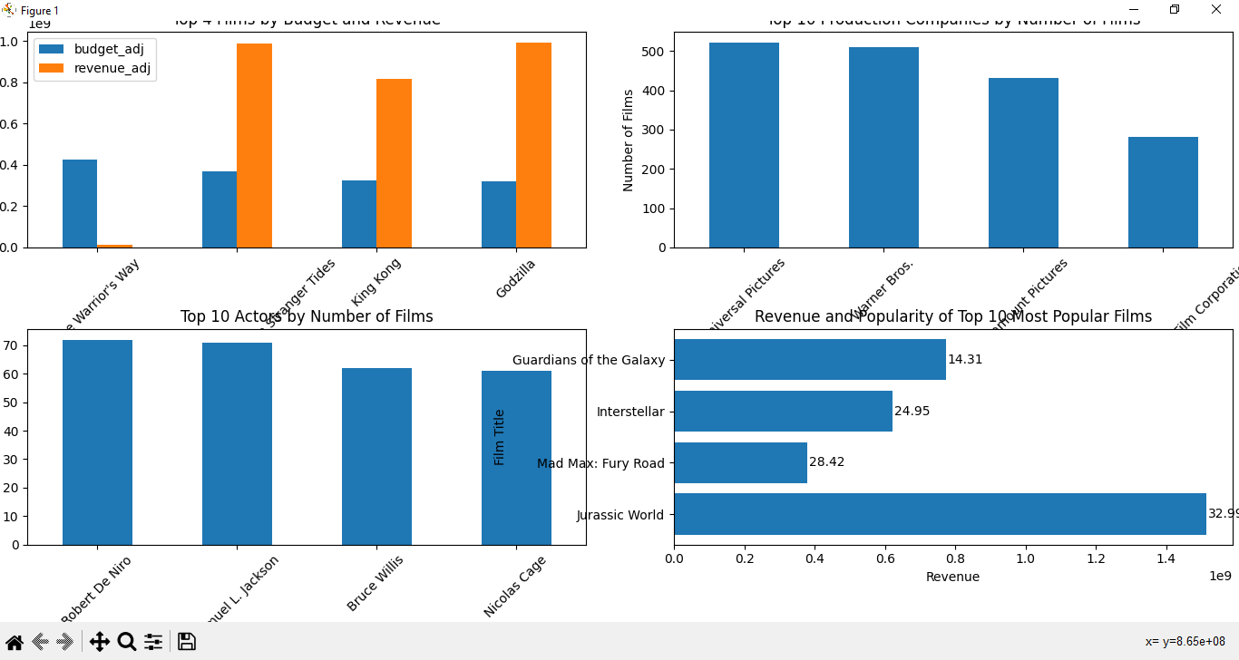
DashBoard

Slide 13

3. Genre Analysis:
Top Genres Represented in Films.
Total Revenue by Genre.

Slide 14
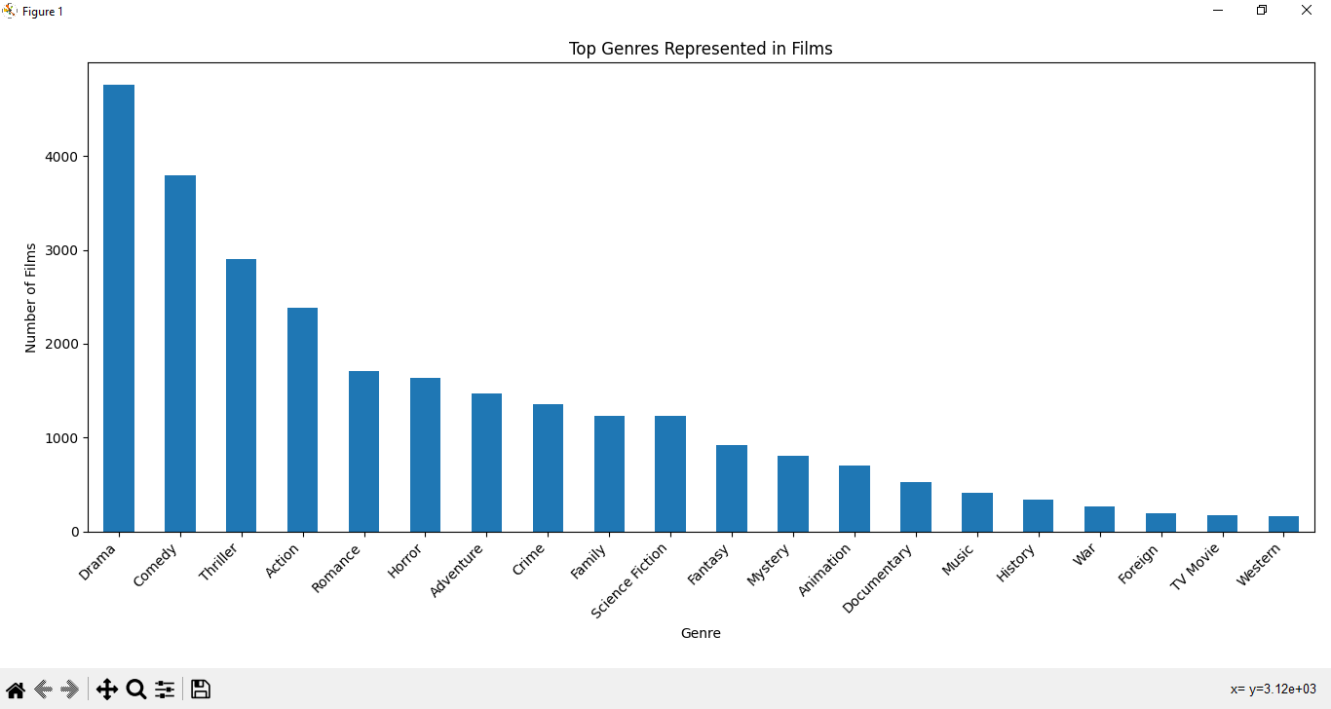
Top Genres Represented in Films

Slide 15
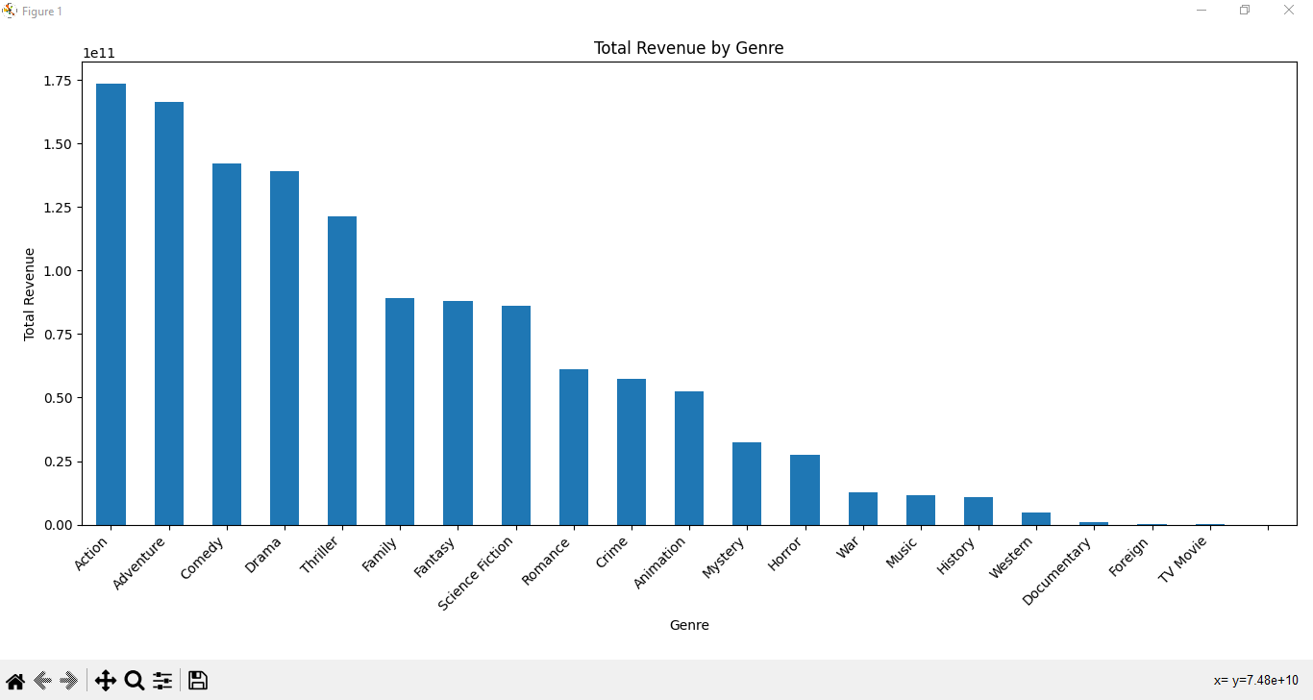
Total Revenue by Genre

Slide 16
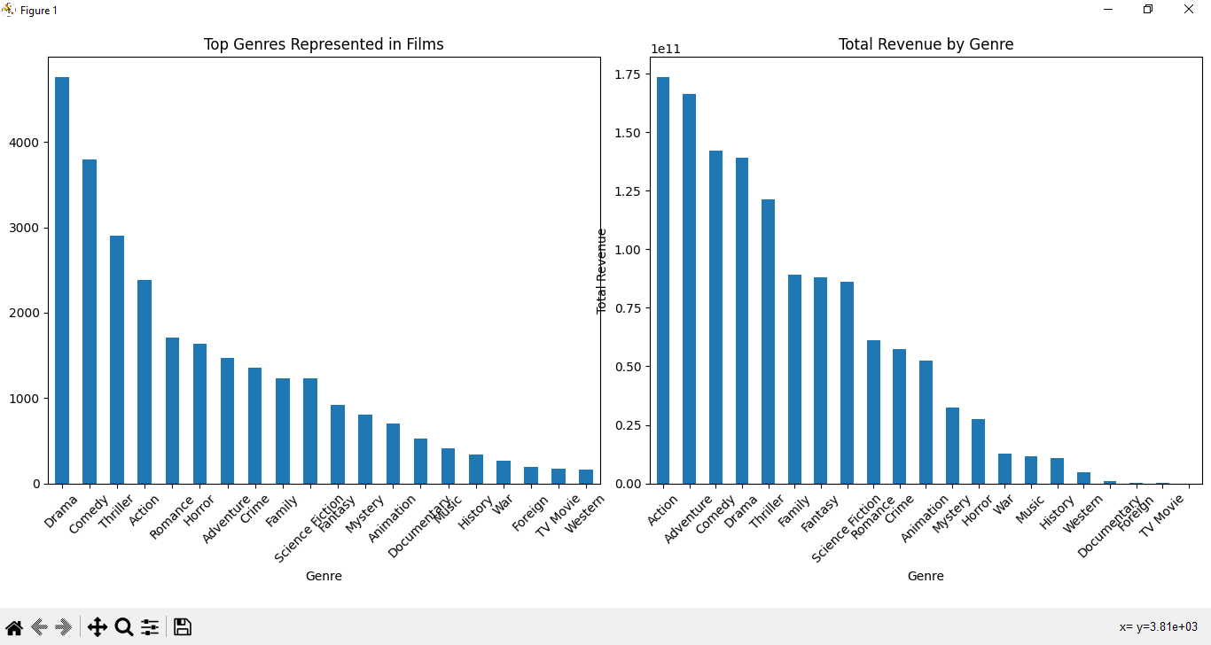
DashBoard

Slide 17
Number of Films Released Each Year from 2005 to 2015

Slide 18

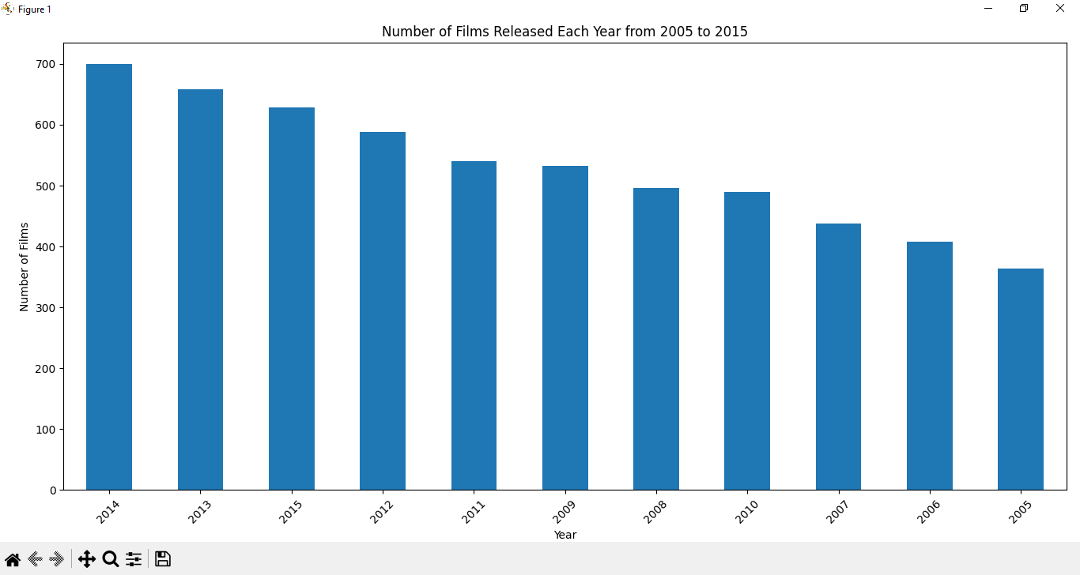

Slide 19
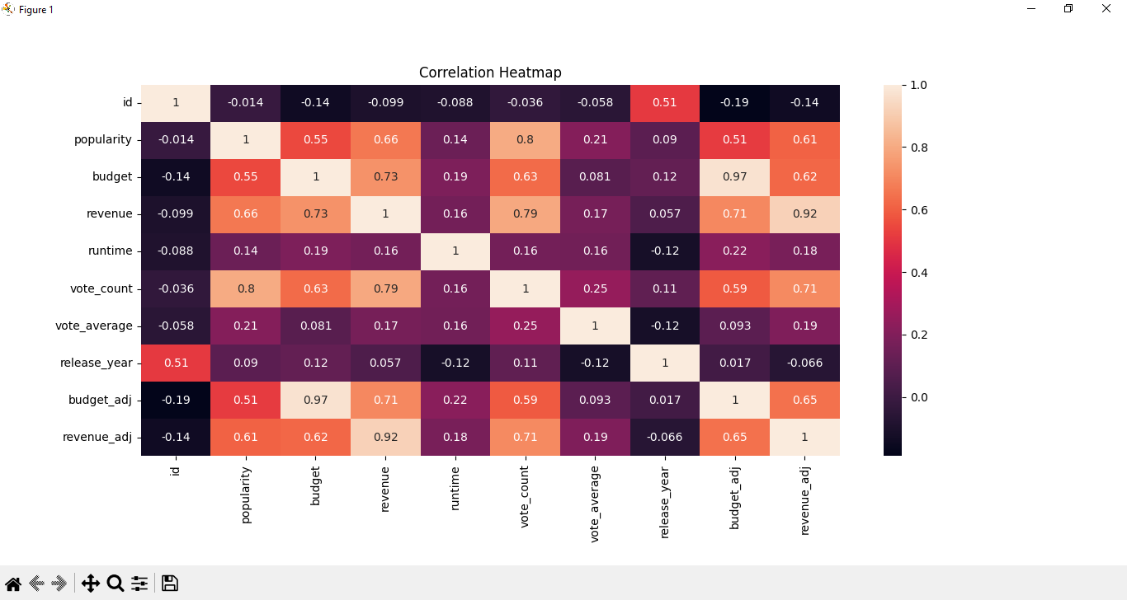
Correlation Heatmap

Slide 20

Thank you very much!

